Slide 1
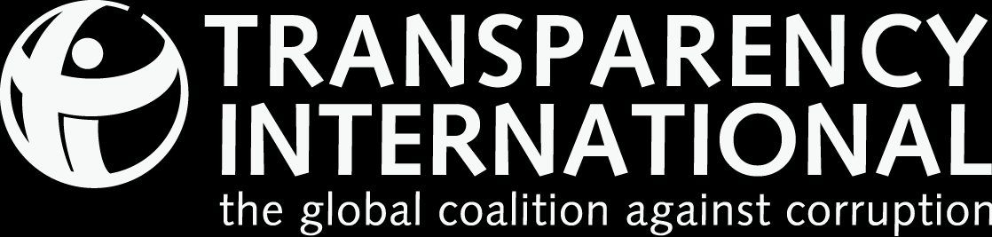
CORRUPTION
PERCEPTIONS
INDEX 2016
The perceived levels of public sector corruption in 176 countries/territories around the world.

Slide 2
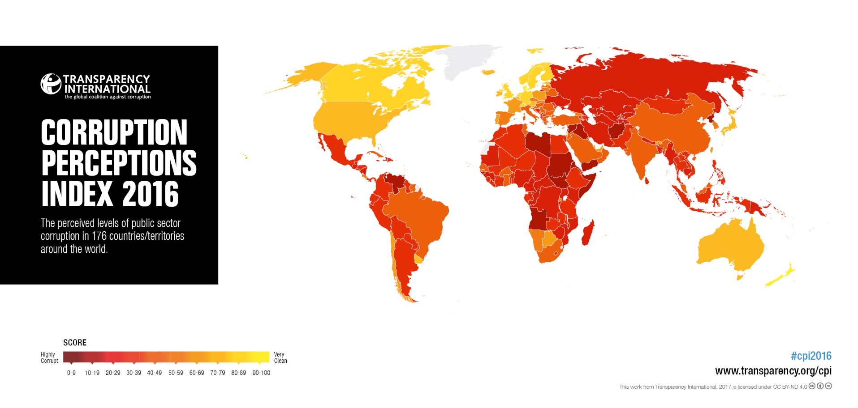
CPI 2016

Slide 3

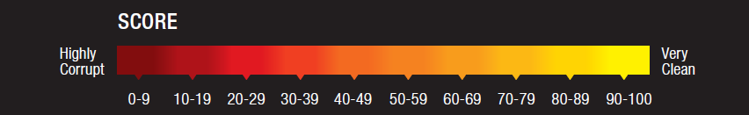
Cpi 2016: The top
RANK | COUNTRY/TERRITORY | SCORE
1 | DENMARK | 90
1 | NEW ZEALAND | 90
3 | FINLAND | 89
4 | SWEDEN | 88
5 | SWITZERLAND | 86
5 | NORWAY | 85
Denmark and New Zealand share first place with score of 90, with other Nordic countries following closely, all helped by strong access to information systems and rules governing the behaviour of those in public positions.

Slide 4
Cpi 2016: The bottom
RANK | COUNTRY/TERRITORY | SCORE
170 | LIBYA | 14
170 | SUDAN | 14
170 | YEMEN | 14
173 | SYRIA | 13
174 | KOREA (NORTH) | 12
175 | SOUTH SUDAN | 11
176 | SOMALIA | 10

Slide 5
Cpi 2016: Main movers since 2012
 | COUNTRY/TERRITORY
 | Greece Senegal United Kingdom Austria Latvia | Czech Republic Albania Indonesia Slovakia
 | Yemen Hungary Malawi Australia Turkey Brazil Madagascar | Spain Mexico Mozambique Sri Lanka Tanzania Uganda Gambia Japan

